Slide 1
Create analytical view in hana
Milind Parab

Slide 2
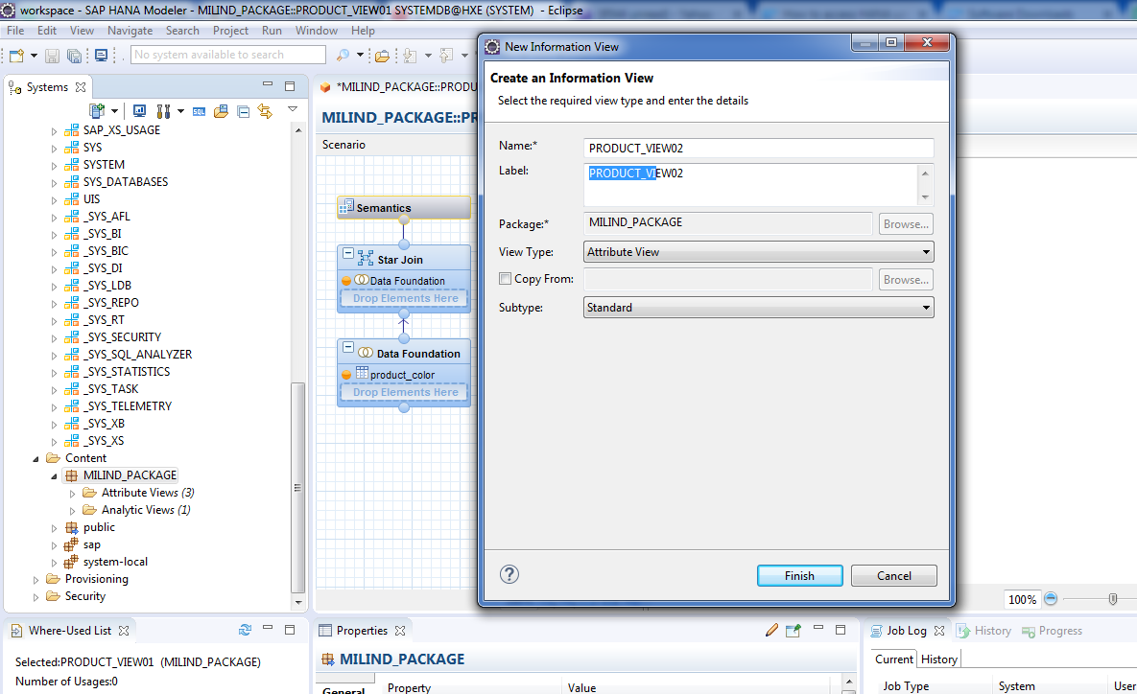
Create an attribute view for product.

Slide 3
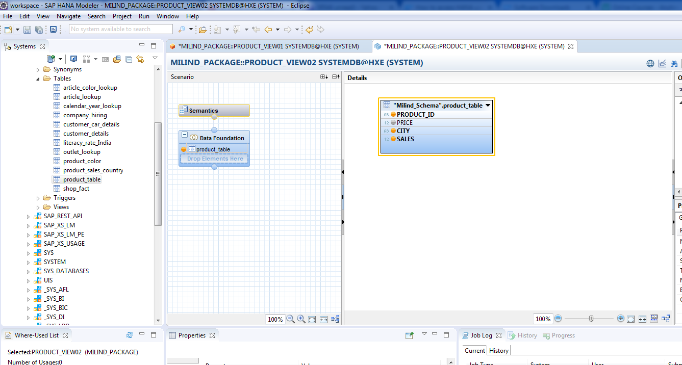
Drag and drop tables.

Slide 4
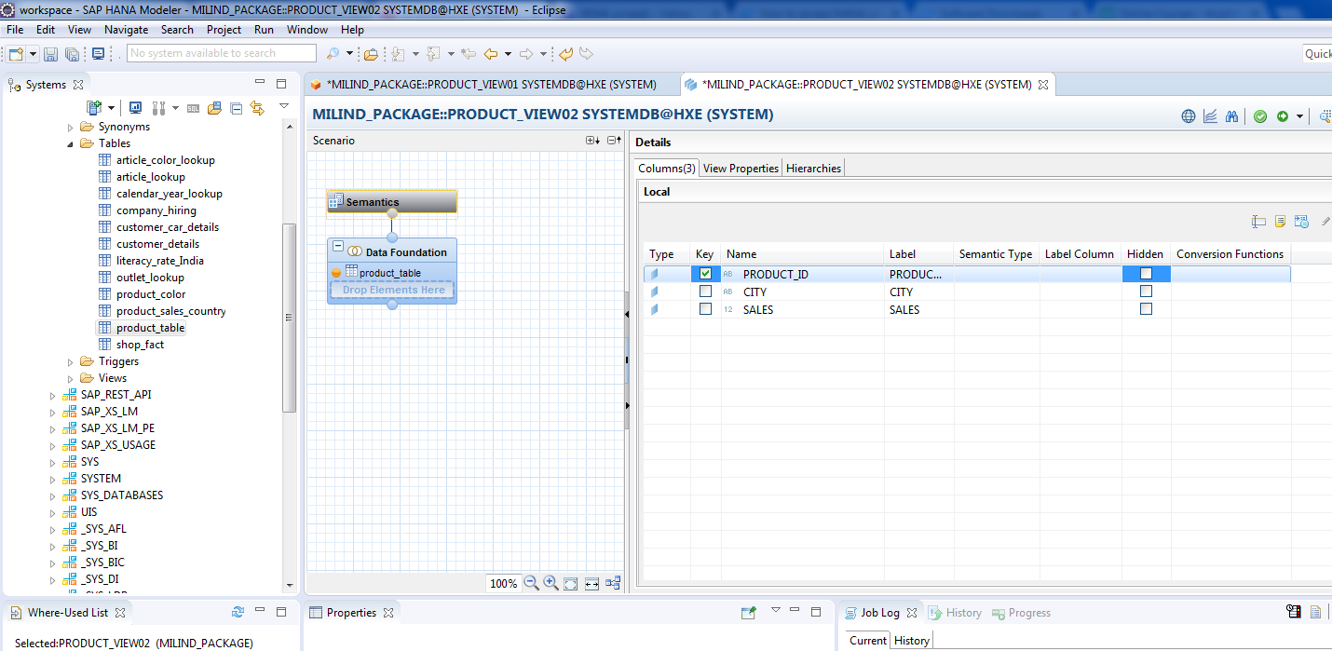
Validate and Activate.

Slide 5
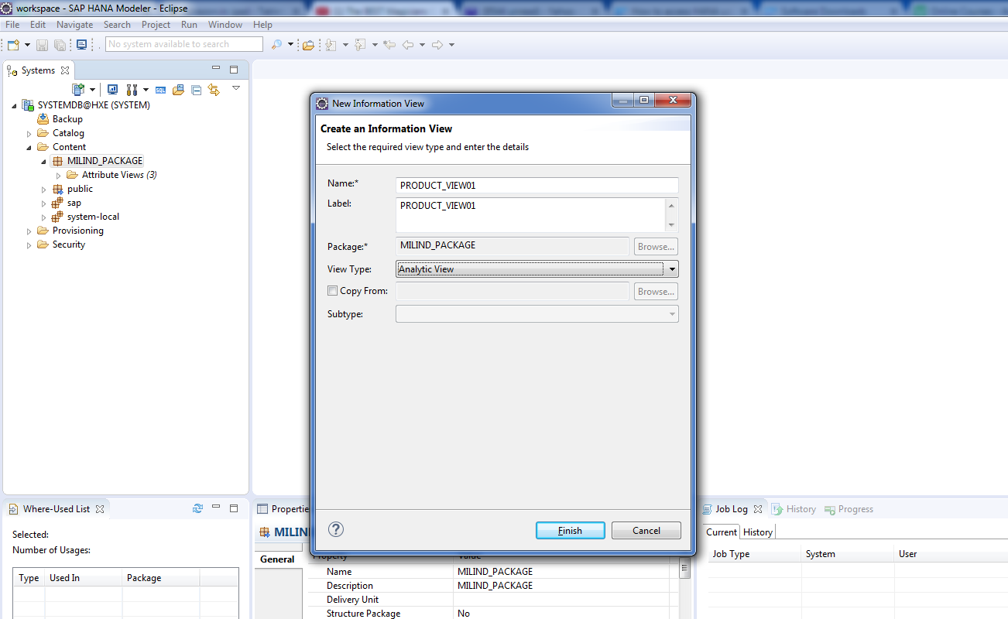
Create an analytical view for product.

Slide 6
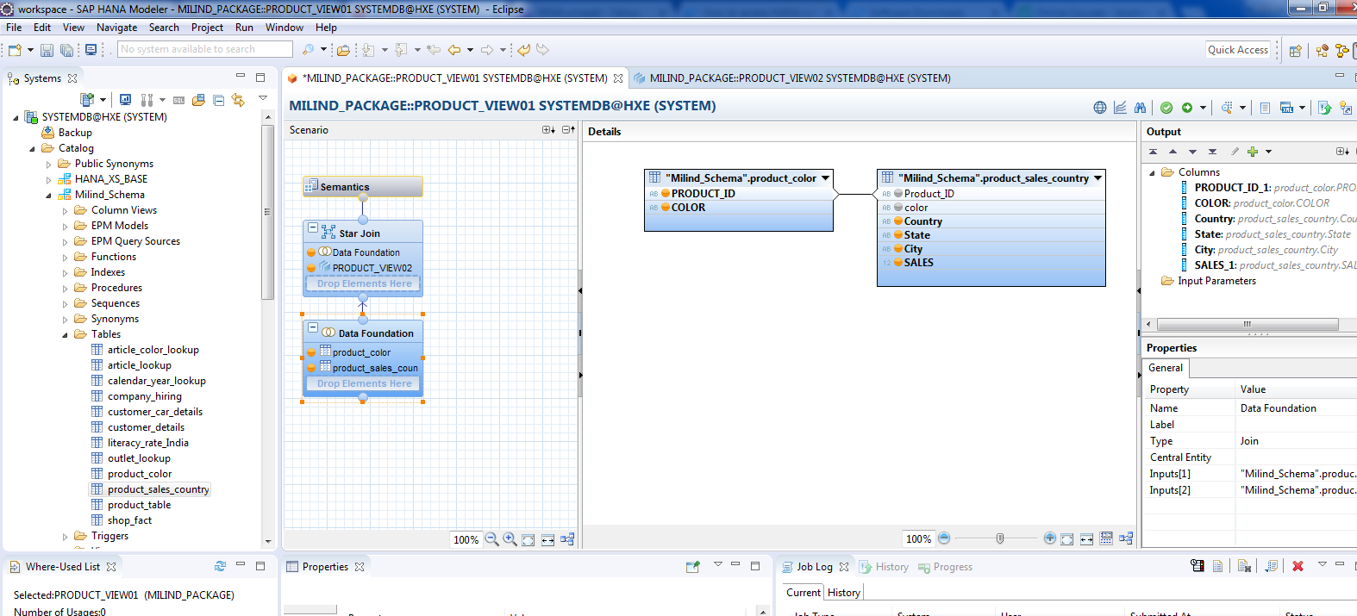
Create data foundation.

Slide 7
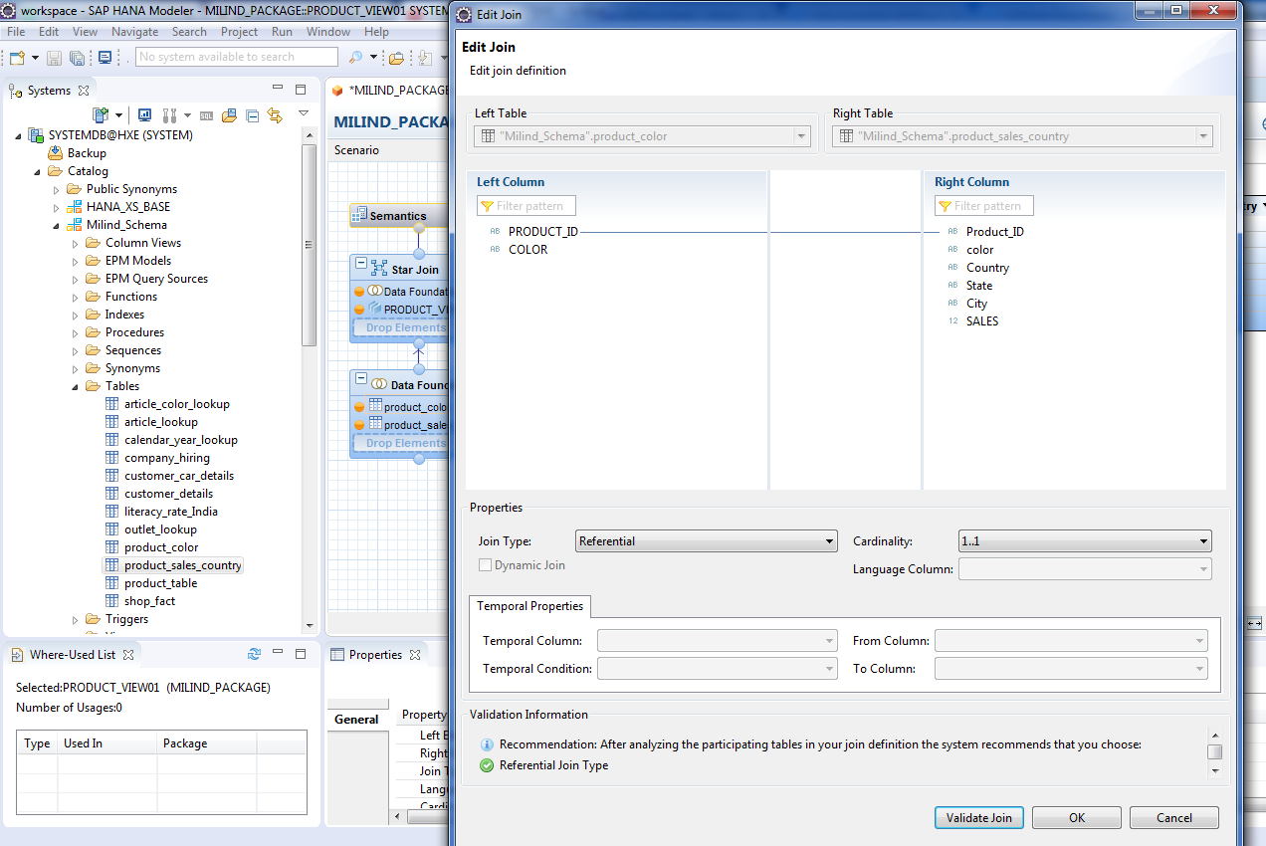
Cont.

Slide 8
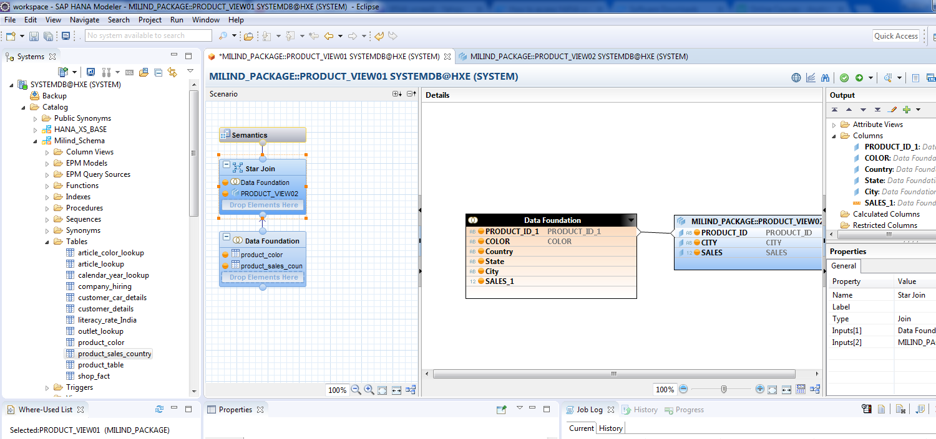
Connect Dimension to fact table.

Slide 9
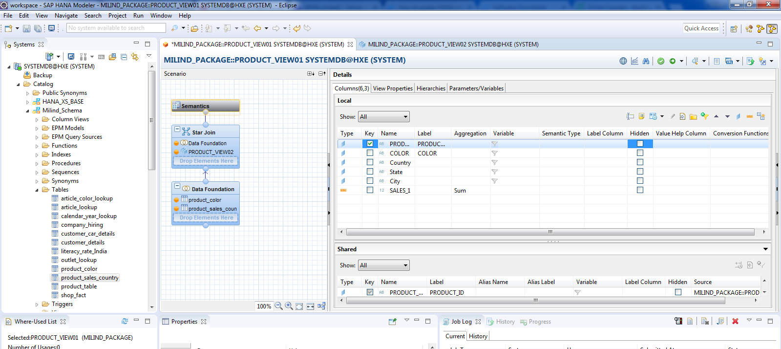
Cont.

Slide 10
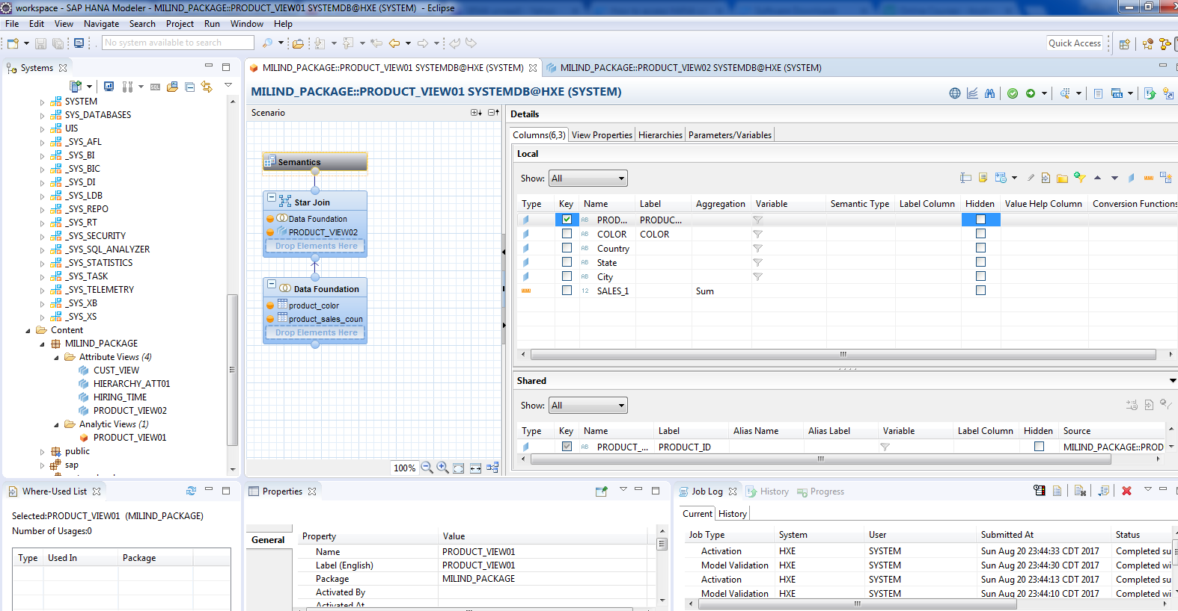
Validate and activate the view.

Slide 11
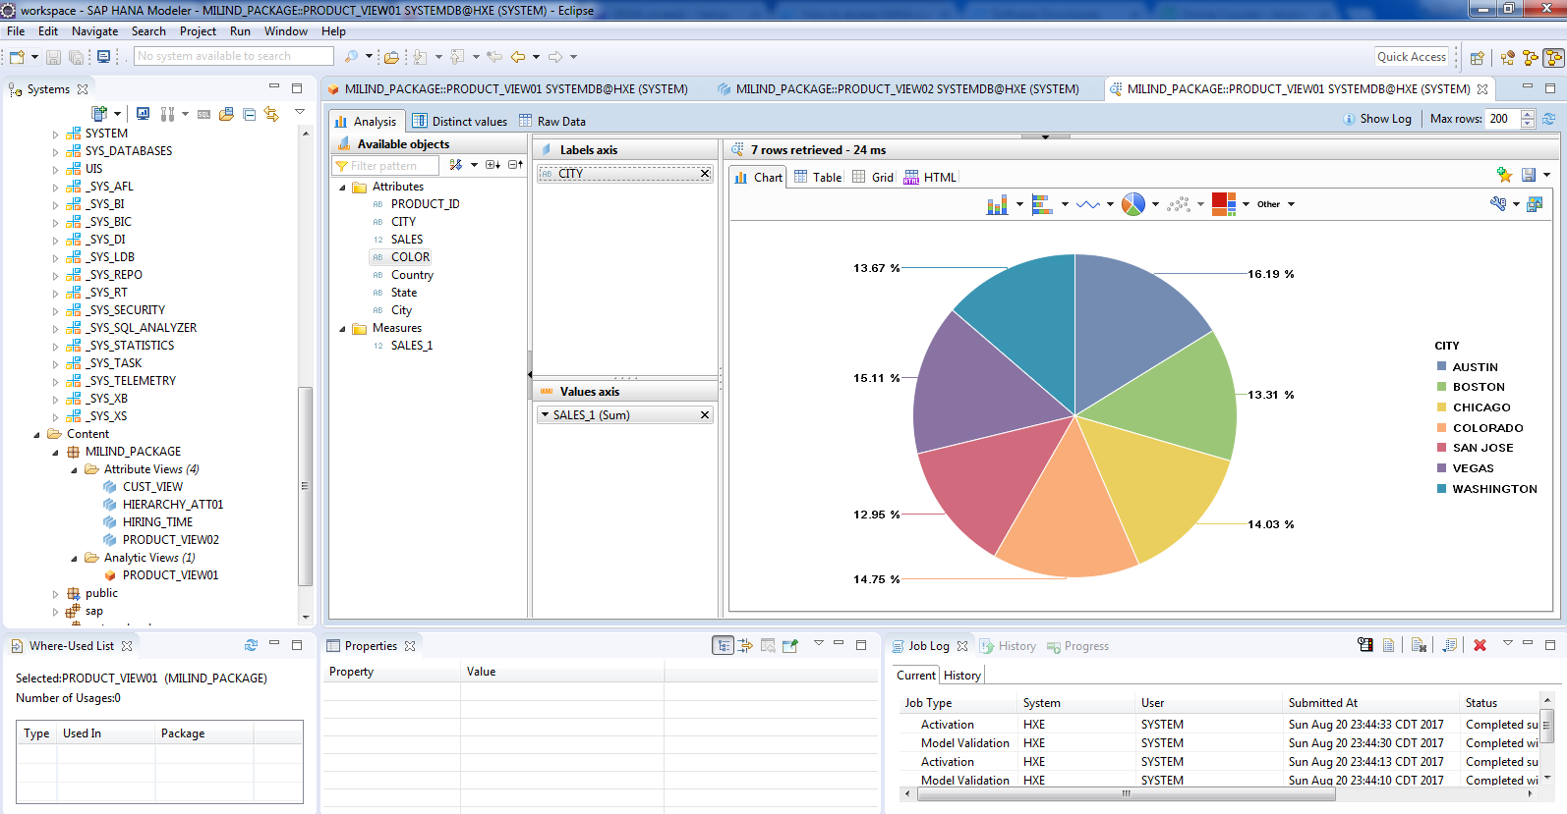
You can view how report would look like.

